Slide 1
Introduction vision
part I

Slide 2
Content
Convolution
Theory
1D
signal -> frequency
2D
Applications
canny edge / optical flow/ shift / cnn / template matching
...

Slide 3
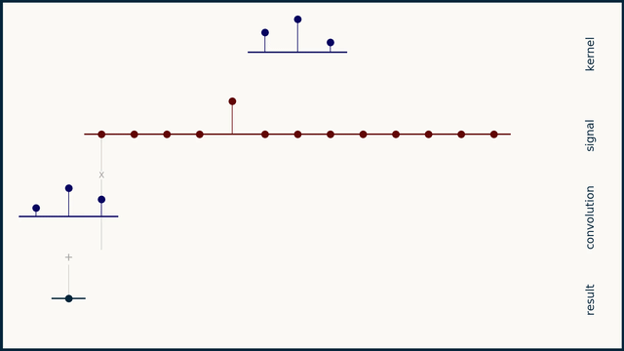
Convolution 1D
https://e2eml.school/convolution_one_d.html

Slide 4
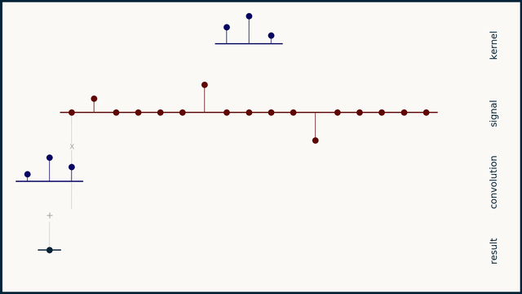
Convolution 1D
https://e2eml.school/convolution_one_d.html

Slide 5
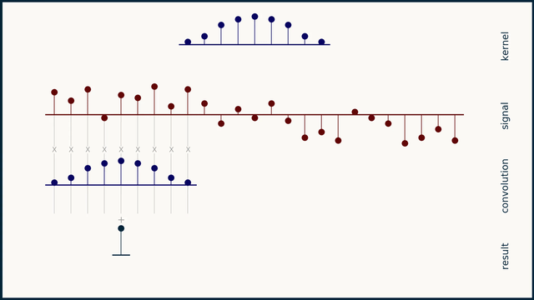
Convolution 1D
https://e2eml.school/convolution_one_d.html

Slide 6
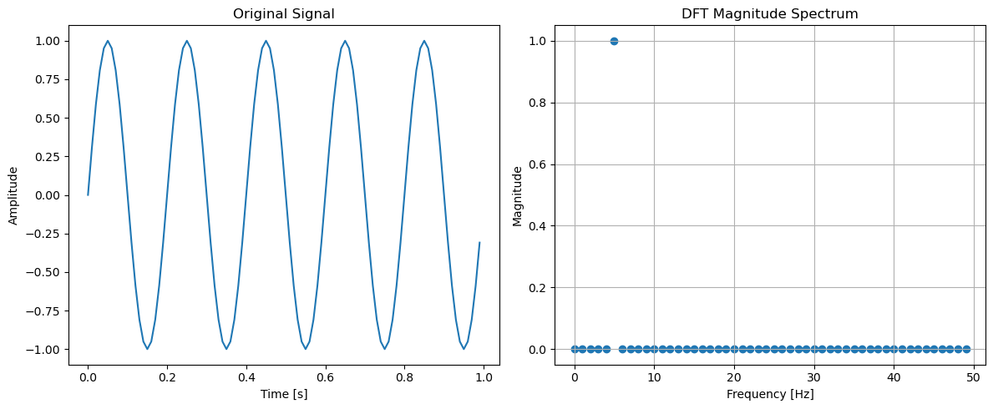
Signal -> Frequency

Slide 7
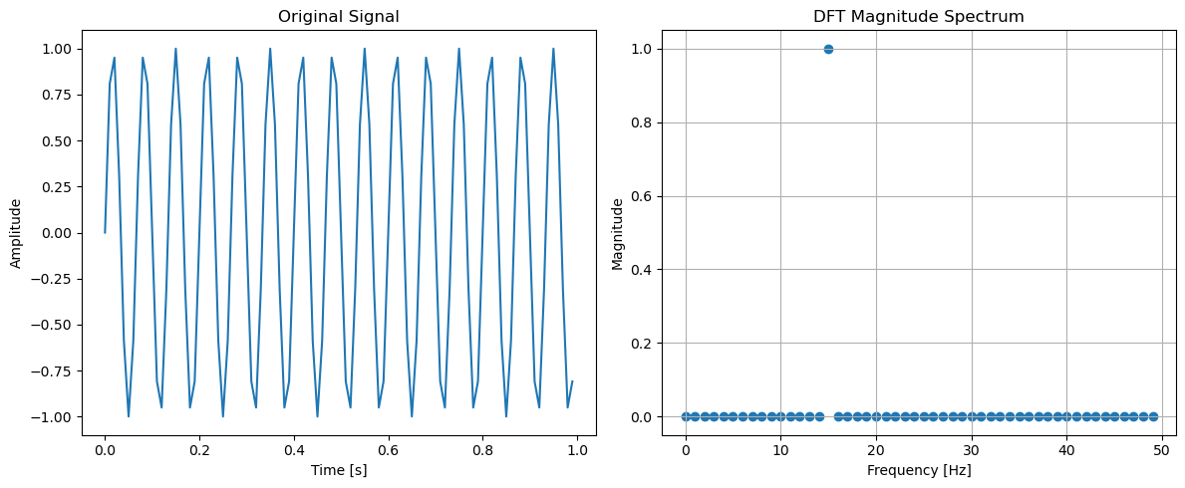
Signal -> Frequency

Slide 8
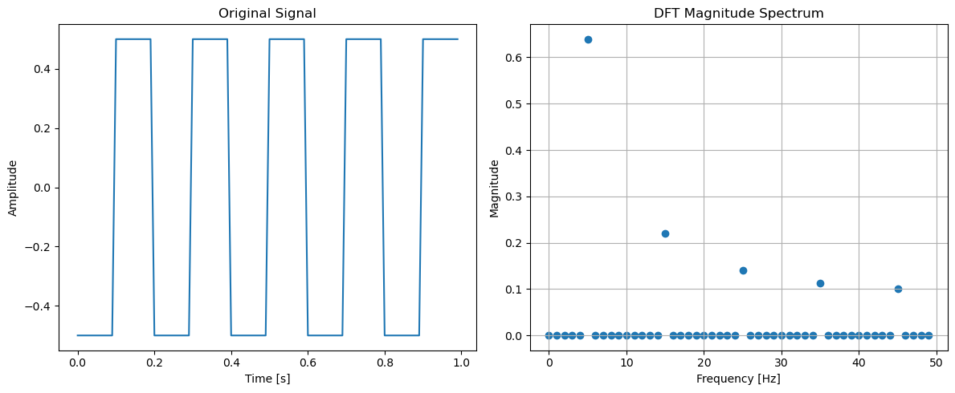
Signal -> Frequency

Slide 9
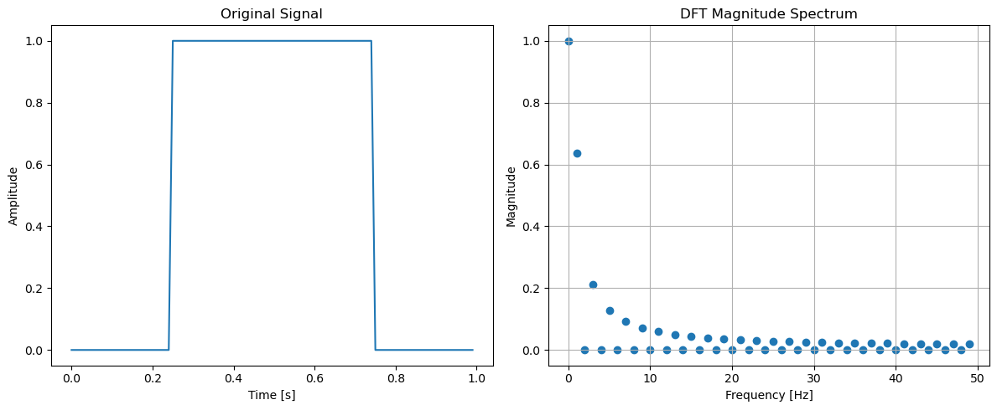
Signal -> Frequency

Slide 10
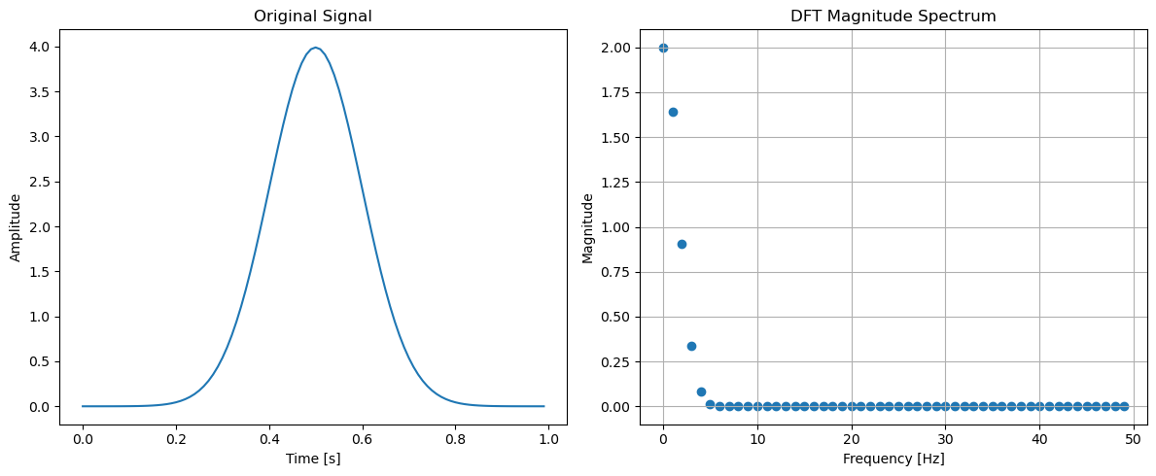
Signal -> Frequency

Slide 11
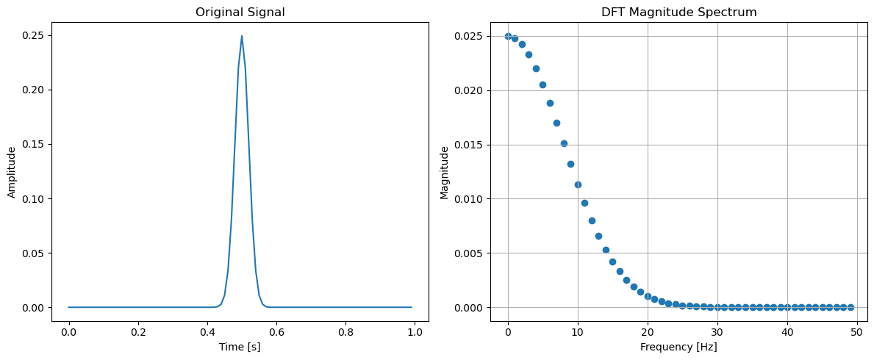
Signal -> Frequency

Slide 12
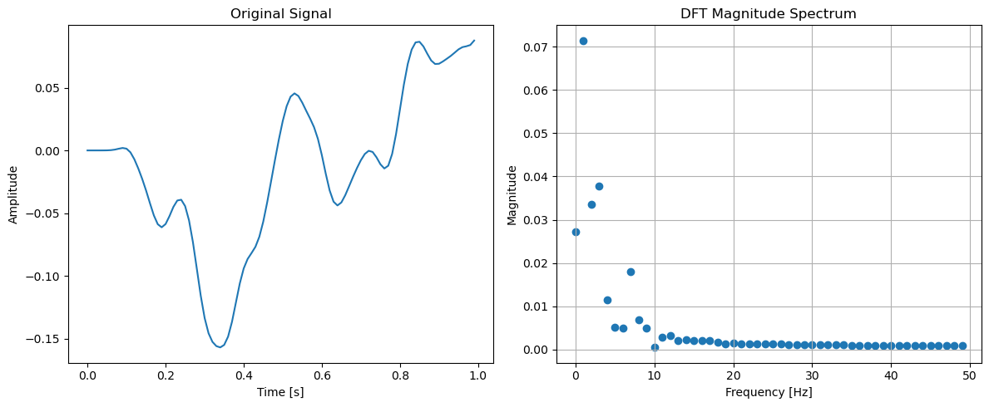
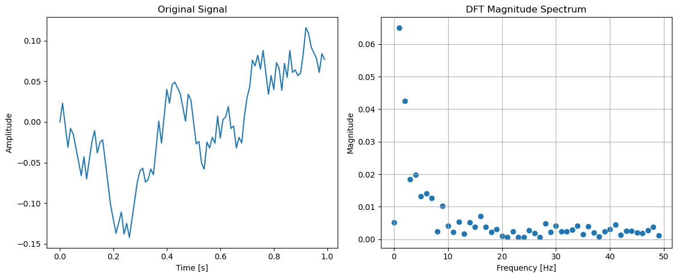
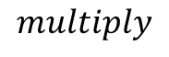


Back to convolution
$$⊗$$
$$multiply$$
$$=$$

Slide 13
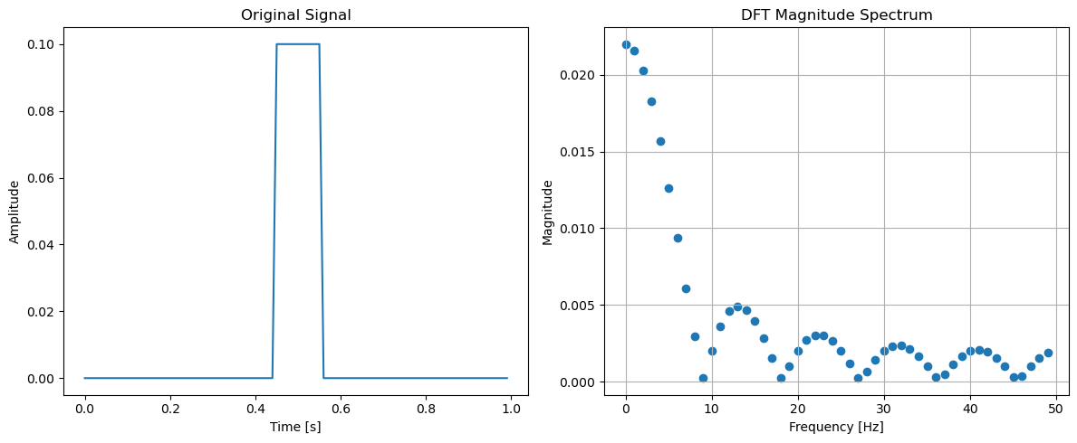
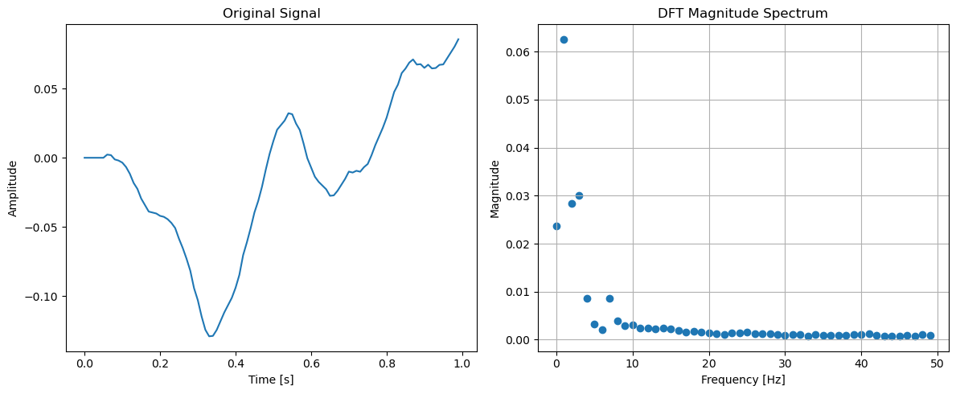
Back to convolution
$$⊗$$
$$=$$
Gaussian blur....

Slide 14
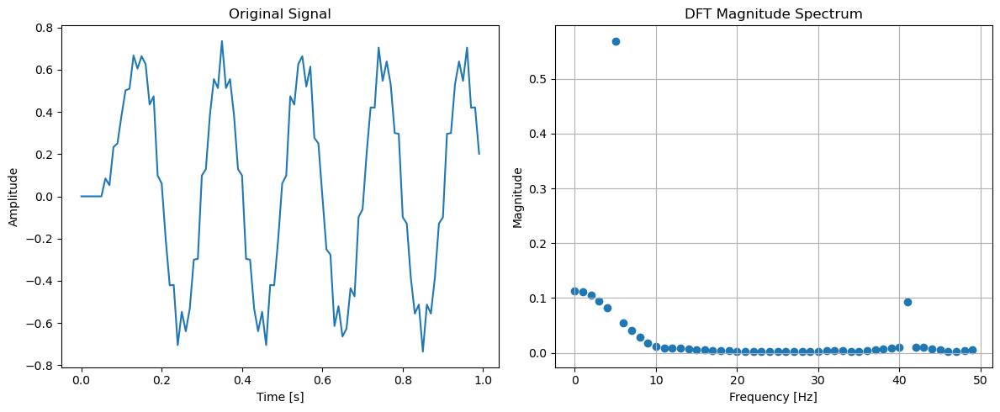
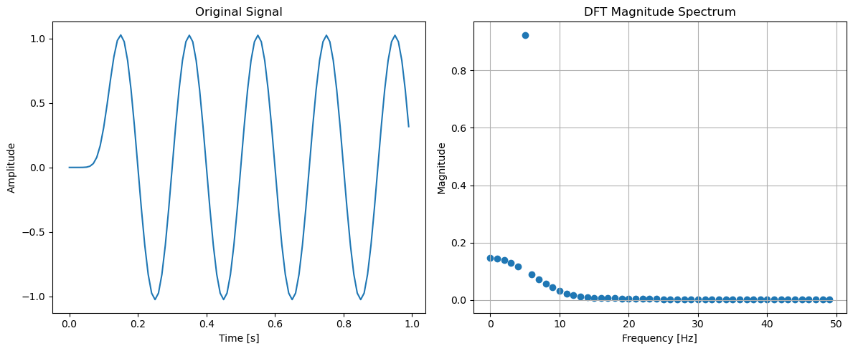
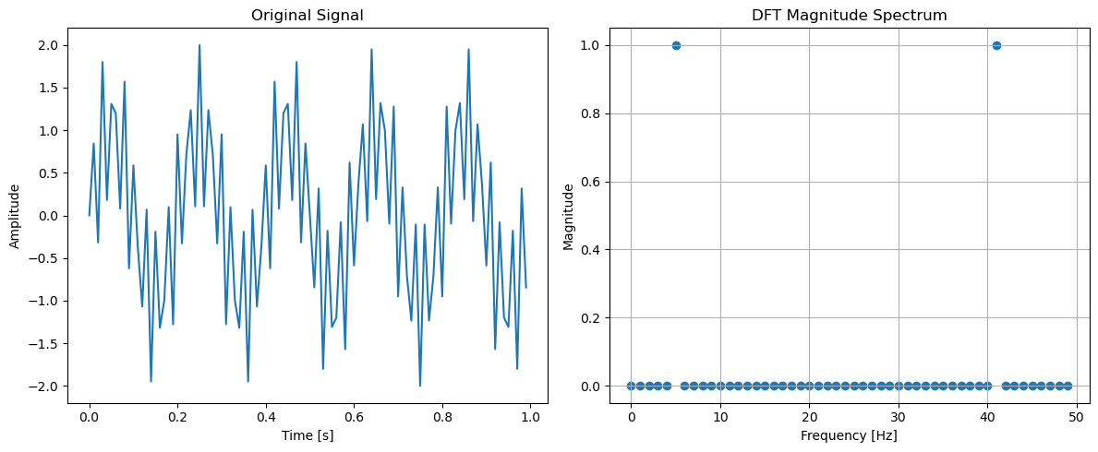

Slide 15
Back to 2D!!!

Slide 16
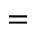

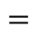

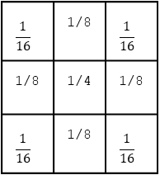
255 | 255 | 255 | 0 | 0 | 0 | 255 | 255
255 | 255 | 255 | 0 | 0 | 0 | 255 | 255
255 | 255 | 255 | 0 | 0 | 0 | 255 | 255
255 | 255 | 255 | 0 | 0 | 0 | 255 | 255
255 | 255 | 255 | 0 | 0 | 0 | 255 | 255
255 | 255 | 255 | 0 | 0 | 0 | 255 | 255
-1 | 0 | 1
-2 | 0 | 2
-1 | 0 | 1
$$⊗$$
$$=$$
255 | 255 | 255 | 0 | 0 | 0 | 255 | 255
255 | 255 | 255 | 0 | 0 | 0 | 255 | 255
255 | 255 | 255 | 0 | 0 | 0 | 255 | 255
255 | 255 | 255 | 0 | 0 | 0 | 255 | 255
255 | 255 | 255 | 0 | 0 | 0 | 255 | 255
255 | 255 | 255 | 0 | 0 | 0 | 255 | 255
$$\frac{1}{16}$$ | 1/8 | $$\frac{1}{16}$$
1/8 | 1/4 | 1/8
$$\frac{1}{16}$$ | 1/8 | $$\frac{1}{16}$$
$$⊗$$
$$=$$

Slide 17
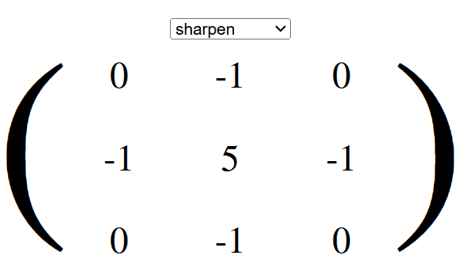
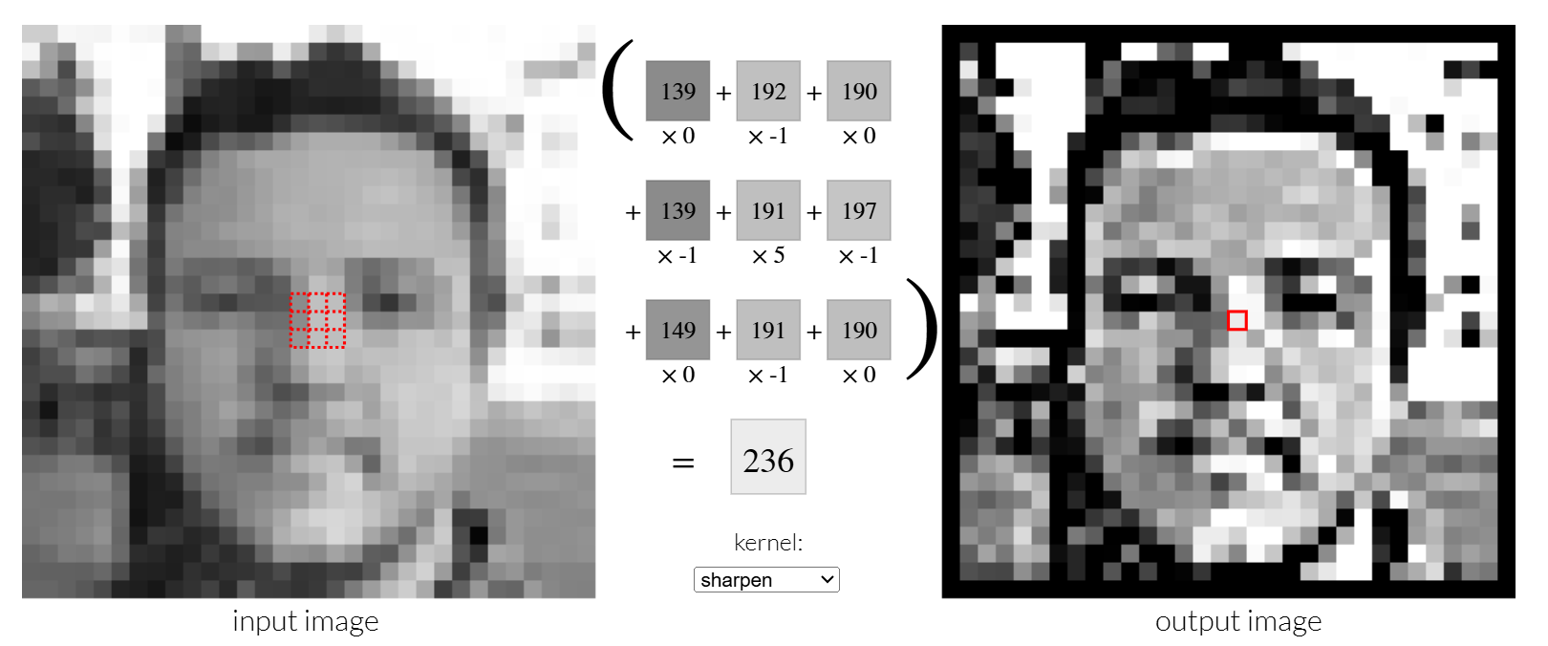
https://setosa.io/ev/image-kernels/

Slide 18
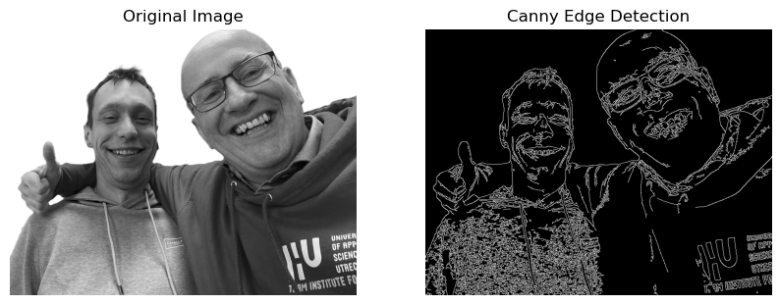
Applications – Canny Edge

Slide 19
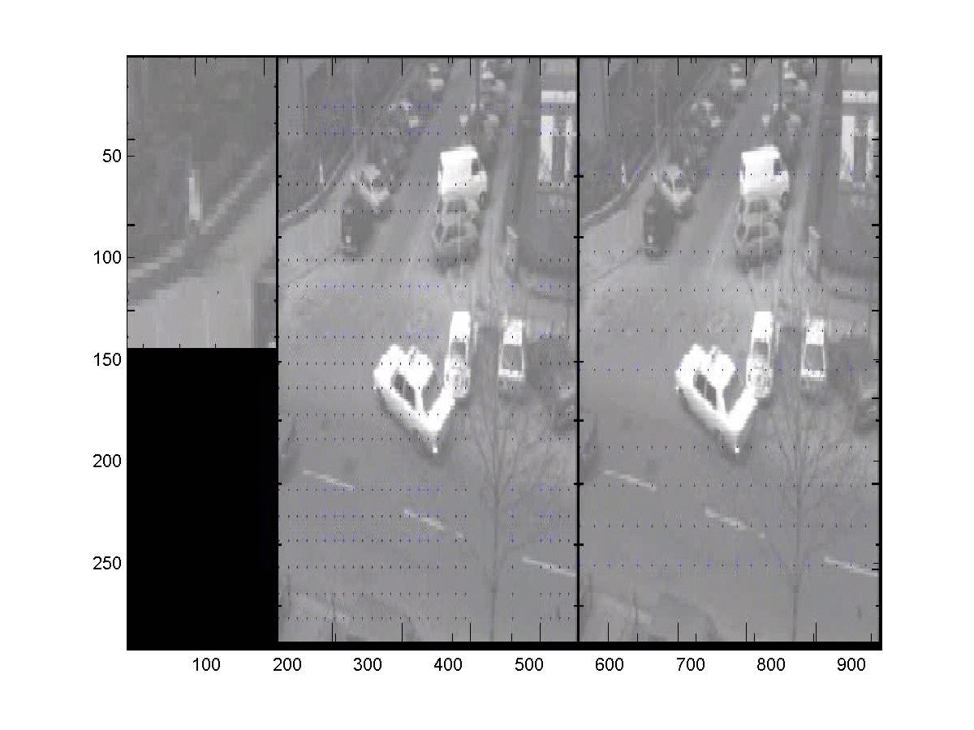
Applications – Optical Flow

Slide 20
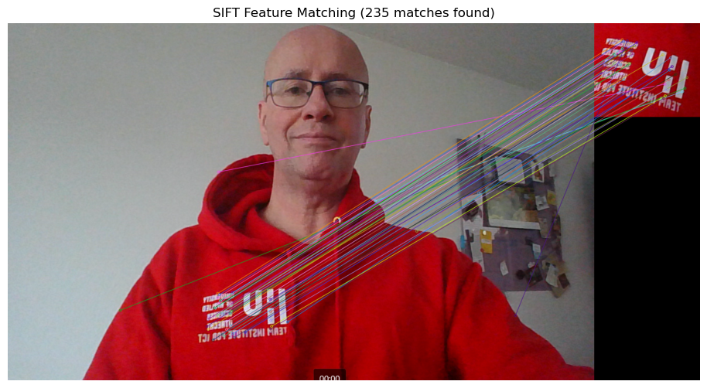
Applications - SIFT
keypoints

Slide 21
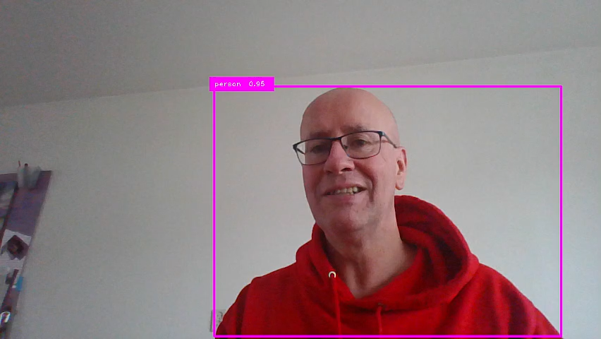
Applications – CNN (Yolo)

Slide 22
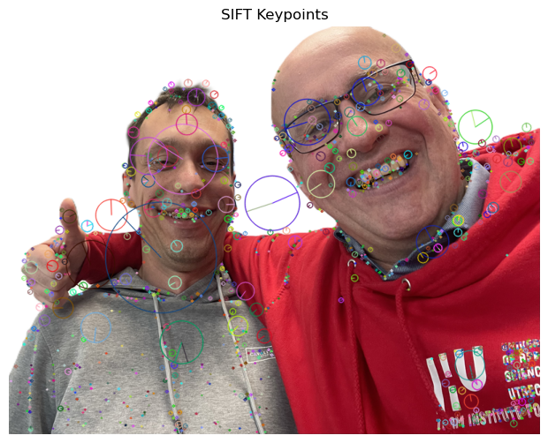
SIFT & Optical Flow -> Op zoek naar patches die matchen

Slide 23
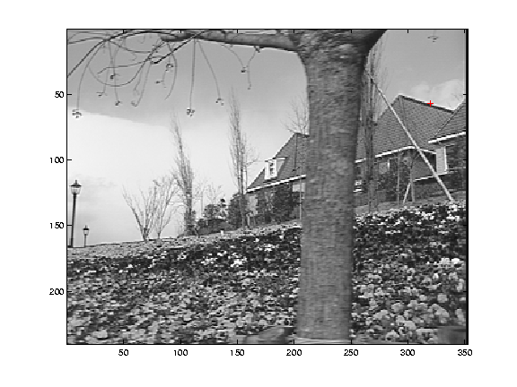
Low-texture region

Slide 24
Edge

Slide 25
High-texture region

Slide 26
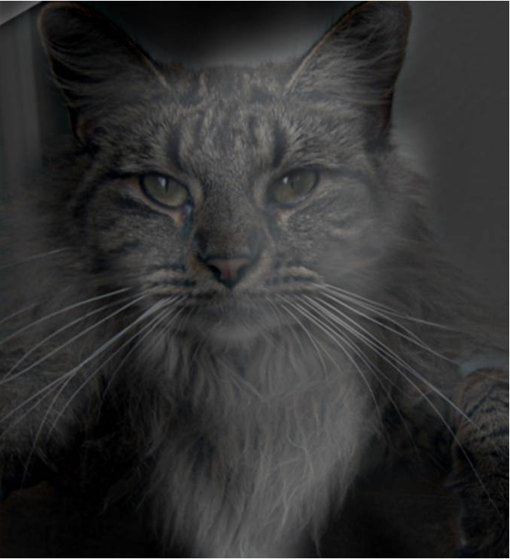
Hybrid Image

Slide 27
Hybrid Image

Slide 28
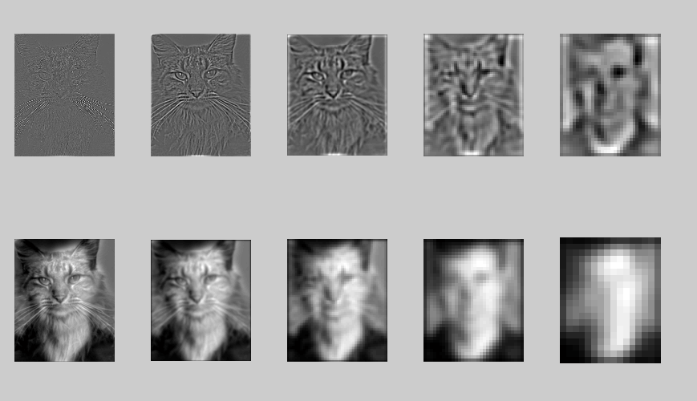
High frequency → Low frequency

Slide 29
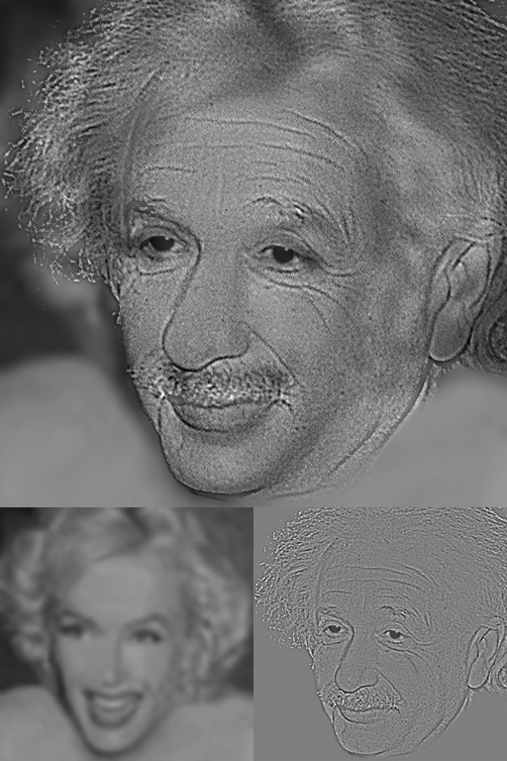
Hybrid Image

Slide 30
Hybrid Image

Slide 31
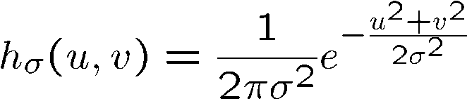
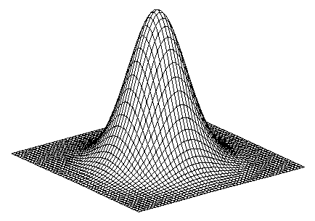
Gaussian
Notes:
How many 2nd derivative filters are there? There are four 2nd partial derivative filters.
In practice, it’s handy to define a single 2nd derivative filter—the Laplacian

Slide 32
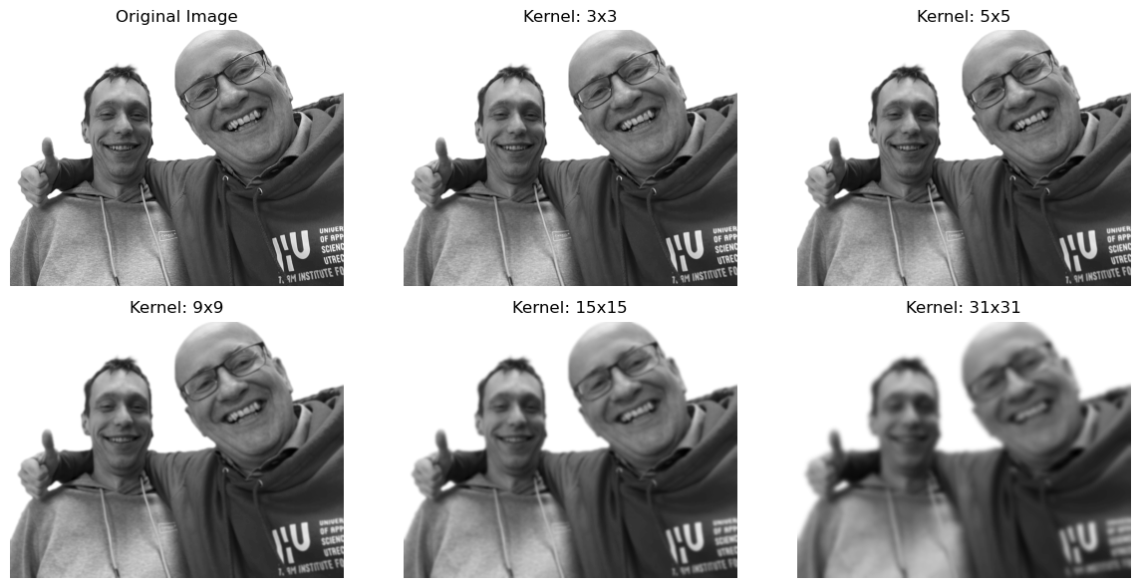
Gaussian
Notes:
How many 2nd derivative filters are there? There are four 2nd partial derivative filters.
In practice, it’s handy to define a single 2nd derivative filter—the Laplacian

Slide 33
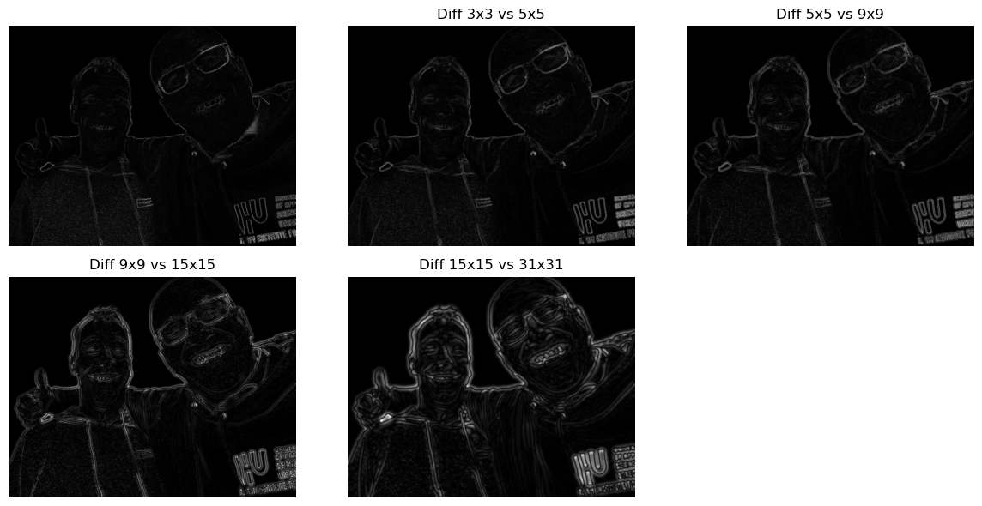
Gaussian
Notes:
How many 2nd derivative filters are there? There are four 2nd partial derivative filters.
In practice, it’s handy to define a single 2nd derivative filter—the Laplacian

Slide 34
Gaussian
Notes:
How many 2nd derivative filters are there? There are four 2nd partial derivative filters.
In practice, it’s handy to define a single 2nd derivative filter—the Laplacian

Slide 35
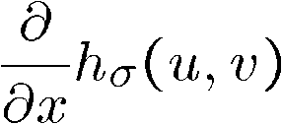
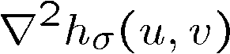
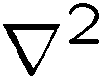
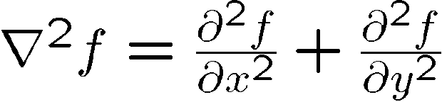
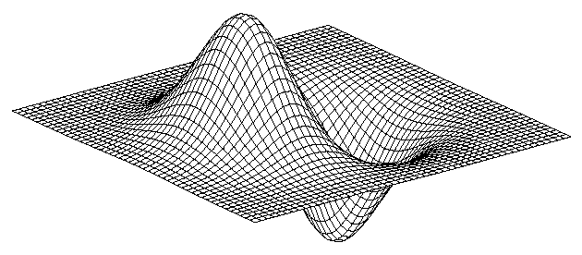
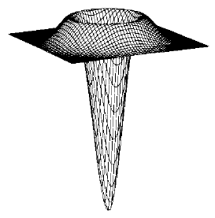
Gaussian
Laplacian of Gaussian
derivative of Gaussian
is the Laplacian operator:
Notes:
How many 2nd derivative filters are there? There are four 2nd partial derivative filters.
In practice, it’s handy to define a single 2nd derivative filter—the Laplacian

Slide 36
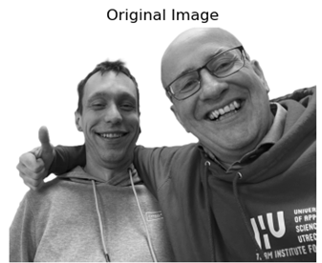
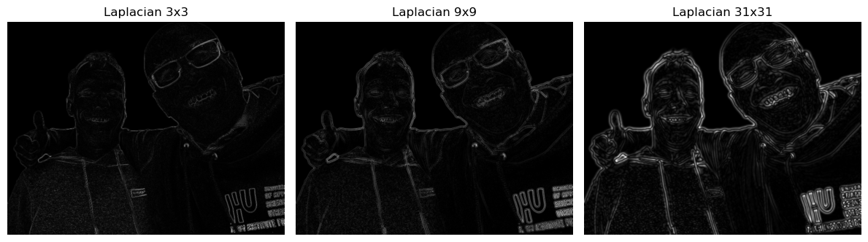
Laplacian of Gaussian
Notes:
How many 2nd derivative filters are there? There are four 2nd partial derivative filters.
In practice, it’s handy to define a single 2nd derivative filter—the Laplacian

Slide 38
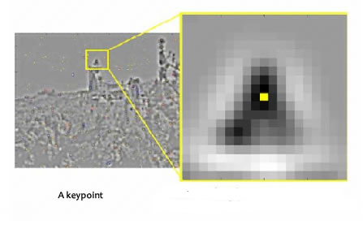
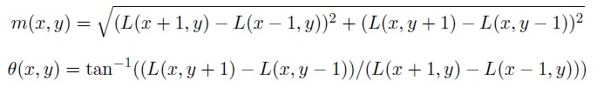
Keypoint beschrijving (1)
Voor alle pixels rondom het keypoint worden de grootte en richting van het intensiteitsverloop berekend:

Slide 39
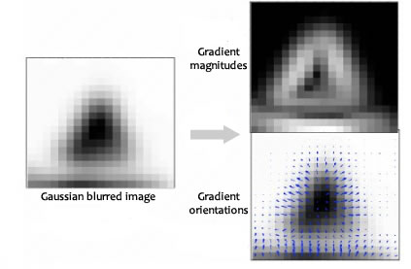
Keypoint beschrijving (2)
Richtingen (θ) worden opgedeeld in 36 histogram bin’s;
0 – 9°, 10 – 19°, etc.;
Aan de bin wordt een waarde toegevoegd overeenkomend met de grootte (m) van het intensiteitsverloop;

Slide 40
Keypoint beschrijving (3) Resultaat

Slide 41

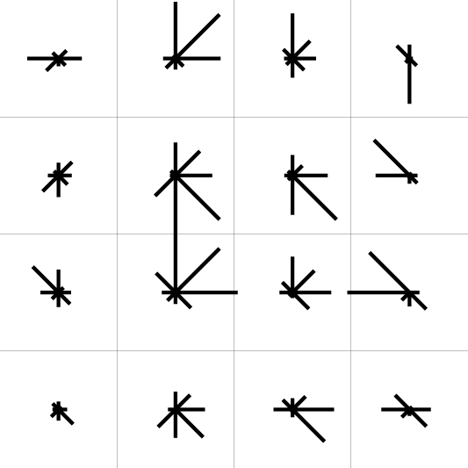
Keypoint beschrijving (4)
Gebruik histogrammen om sub-patches rondom het keypoint te ordenen op basis van oriëntaties:
0
2
π
https://www.cs.ubc.ca/~lowe/keypoints/

Slide 42
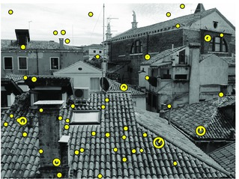
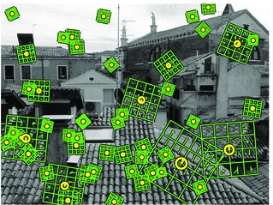
SIFT met de descriptors

Slide 43
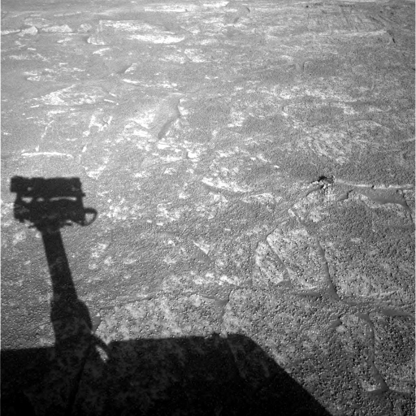

Challenge: waar zijn we?

Slide 44


NASA Mars Rover images with SIFT feature matches
Figure by Noah Snavely

Slide 45

Keypoint matching t.b.v. stitching

Slide 46

Keypoint matching t.b.v. stitching

Slide 47



Slide 48




$$⊗$$
https://debuggercafe.com/template-matching-with-opencv/

Slide 49

Break?

Slide 50
Content
Convolution
Theory
1D
signal -> frequency
2D
Applications
canny edge / optical flow/ shift / cnn / template matching
...

Slide 51
Content
Convolution
Theory
1D
signal -> frequency
2D
Applications
canny edge / optical flow/ shift / cnn / template matching
Color space
RGB, HSV
Hough transform
Poly detection

Slide 52




Color space
CMYK (voor druk/print)
HSV
H- kleur
S - hoeveel
V - hoe donker
RGB red, green, blue

Slide 53


